Slide 1
Incrementality is a must-have for the modern marketer

Slide 2
The Privacy Era is here!
User-level media measurement is no longer possible.

Slide 3
The marketer’s job today is more difficult than ever.
How do I prove the value of marketing to the business?
How do I allocate budget most effectively, or where do I spend the next dollar?
How do I know the impact of my media as privacy/tracking rules evolve?
How do I efficiently run a testing, measurement, and optimization practice?
How do I triangulate measurement methodologies for a clear investment decision?

Slide 4

Brands must shift to future-proof measurement
User Level
Cohort Based
Correlation
Causation
3rd Party Data
1st Party Data
Last Touch, MTA
Incrementality

Slide 5


“Incremental measurement, which allows for decisions to be made under the light of causal performance, is not a nice-to-have, but a crucial must-have.”
“Regardless of your business or budget size, you need to understand the concept of Incrementality. “

Slide 6
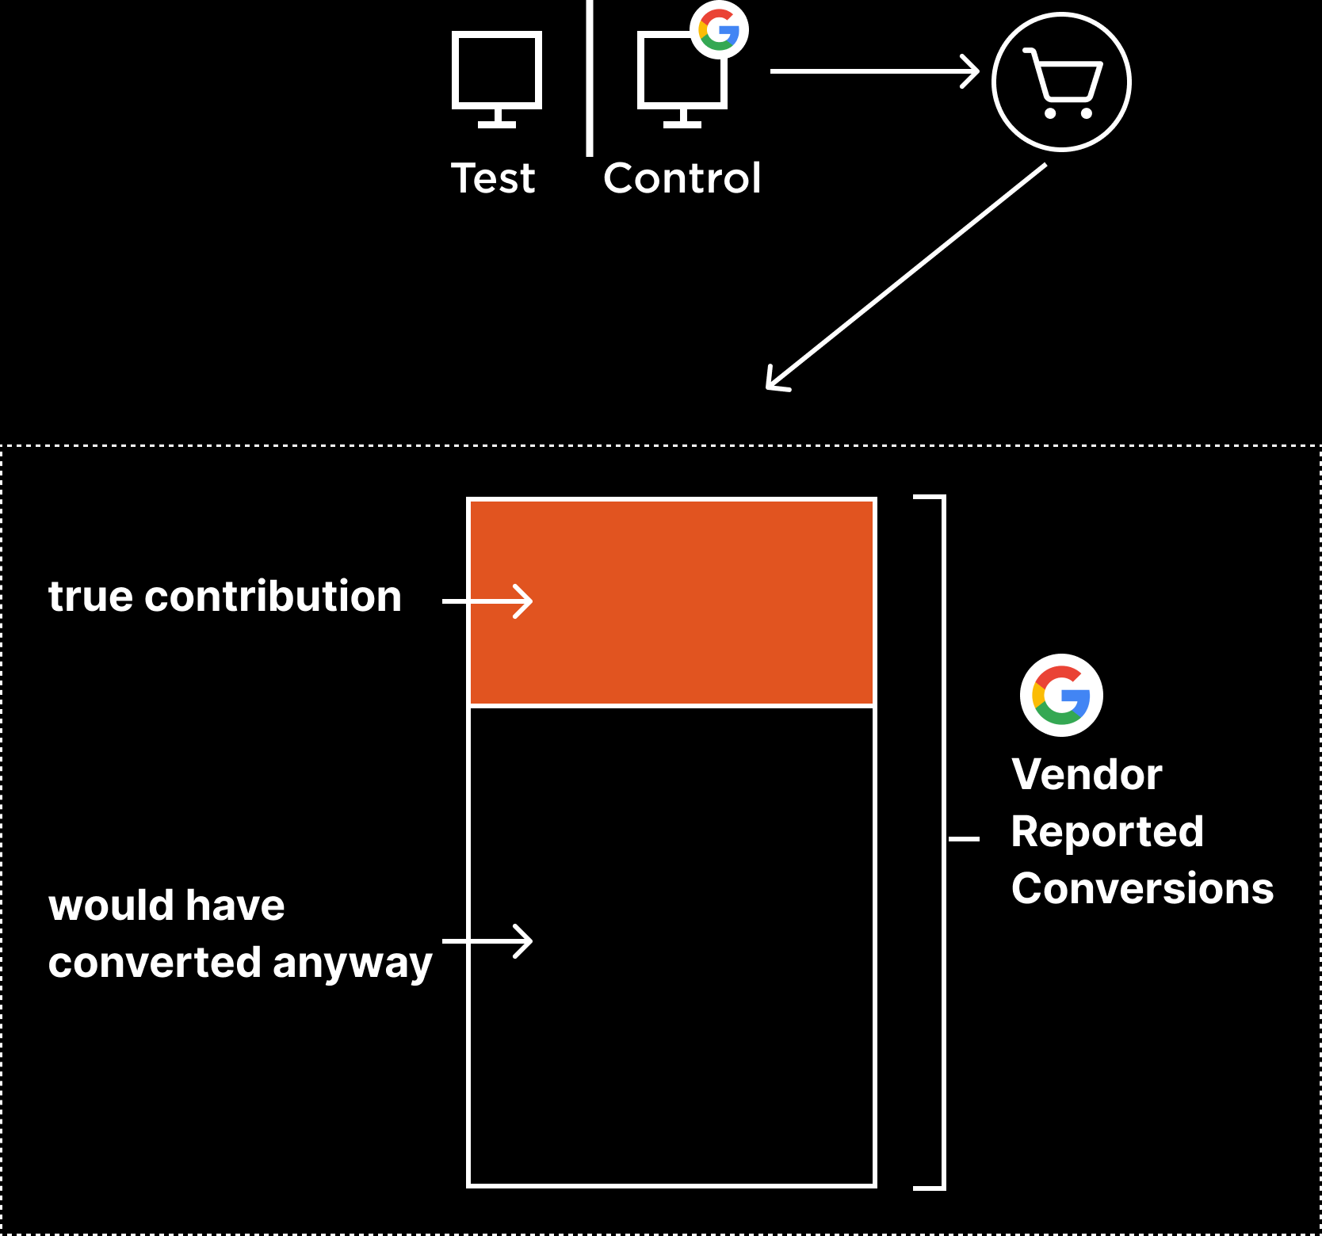
What is Incrementality (i)?
Incrementality is the practice of using test-and-control measurement to reveal the true lift of media.
2 observe sales
1 holdout media
3
report inc

Slide 7
Incrementality learnings from this quarter
Big Portfolio Efficiency Gains
TikTok Drives New Customers
Branded Search Not Incremental
Meta ASC Works for Some Brands
Premium Fashion Retailer
Enterprise Home Services Co
Luxury Fashion Brand
Measured Portfolio Average
-46%
99%
$4.0
$4.0
91%
2X
5X
$3.5
Spend Decrease
Orders Retained
Incremental Sales by New Customers
Increase in TikTok Spend post-test
Google Overreporting Contribution to Sales
100X
$1.4
ROI on Measured Investment
Brand Median Quartile ROAS
Brand Upper Quartile ROAS

Slide 8
Thank You

